Slide 1

Predicting ed disposition using triage data

Slide 2
The Problem
To help the hospital providing adequate resources and shorten the ED Length of Stay for a patient, it will be very helpful if there is a way to predict hospital admissions right after Triage.

Slide 3
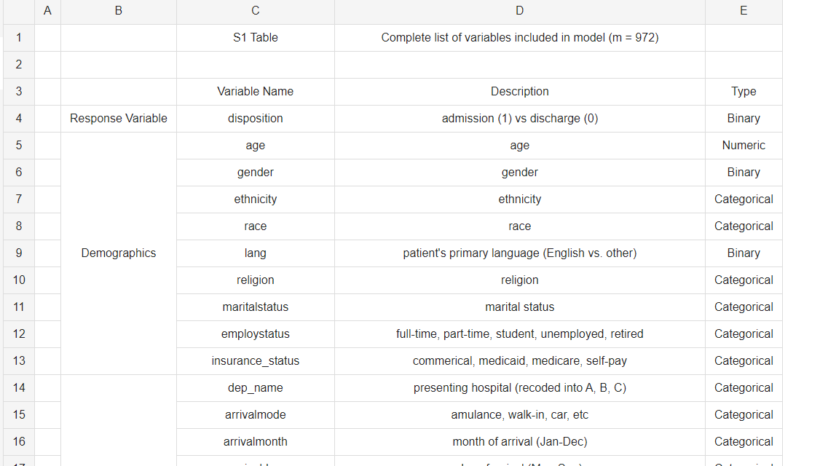
Data source
Data Source:
Wook Suk Hong, Adrian Daniel Haimovich, R. Anndrew Taylor
https://figshare.com/articles/dataset/Predicting_hospital_admission_at_emergency_department_triage_using_machine_learning/6846524

Slide 4
Data wrangling
Data Size: 972 Variables, 560,486 rows
Fill Null values to 0 when is Binary Type. Full According to its category when in Categorical type
Didn’t delete any rows.
Target Variable: Disposition

Slide 5
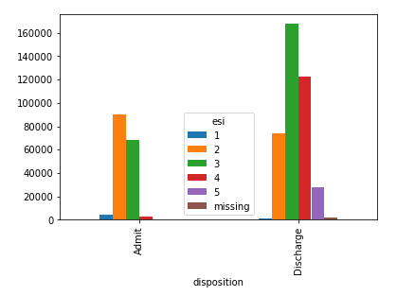
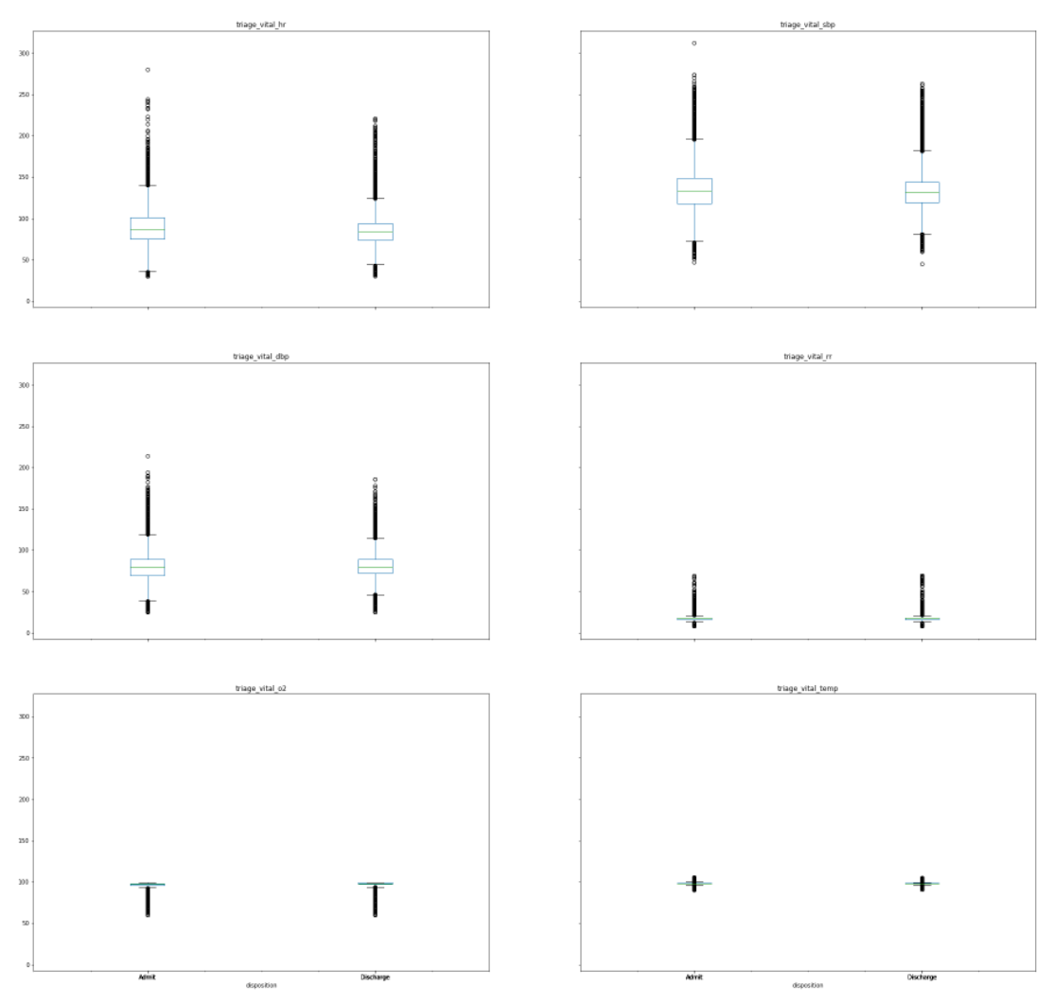
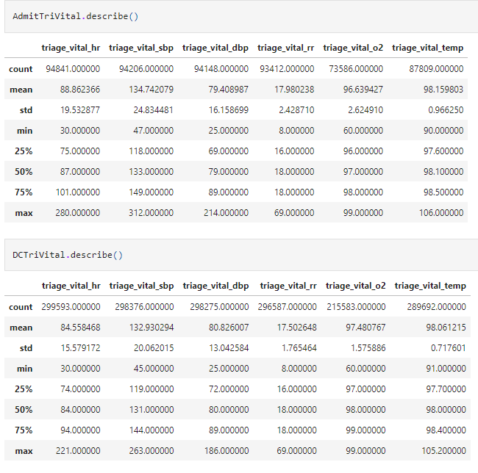
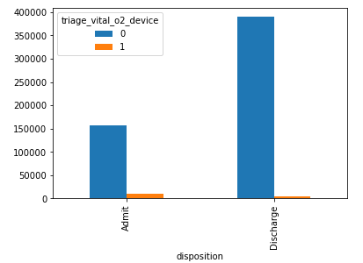
EDA

Slide 6
Model Selection
3 different dataset: Triage Data Only, Historical Data Only, Full Dataset
Logistic Regression
GradientBoosting

Slide 7
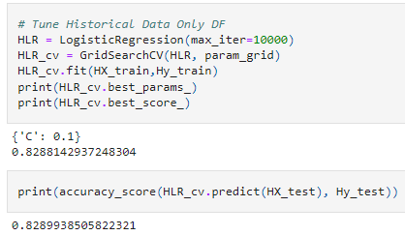
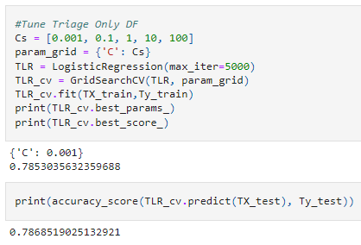
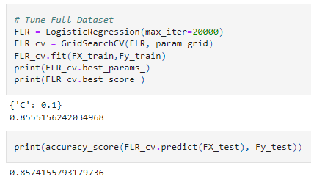
Logistic Regression Grid Search CV

Slide 8
Learning Rate Tuning for Gradient boosting
For Triage Only Dataset, the best learning rate is 0.75
For Historical Only Dataset, the best learning rate is 0.75
For Full dataset, the best learning rate is 1

Slide 9
AUC Score for LR and GB
 | LR AUC Score | GB AUC Score
Triage Only Data | 0.843 | 0.859
Historical Only Data | 0.857 | 0.865
Full Dataset | 0.914 | 0.922

Slide 10
Conclusion
Full Dataset with Gradient Boosting is the best model
Feature is important to get the correct prediction

